Slide 1
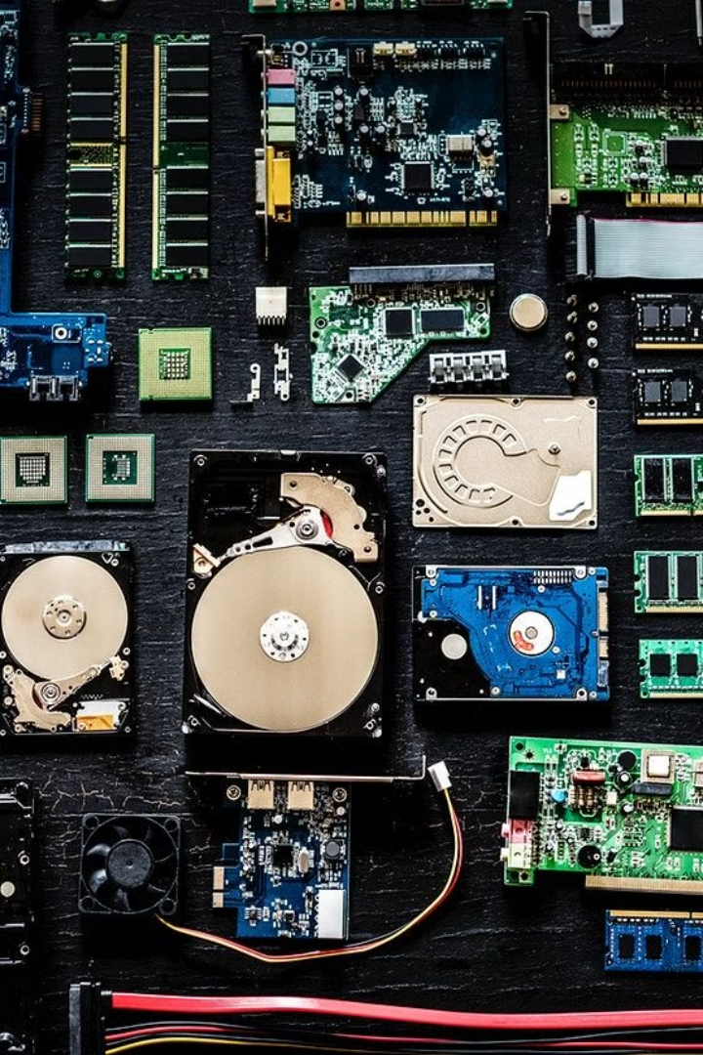

What are Computer Parts?
Computer parts are the physical components that make up a computer. Each part has a specific job, and together, they allow the computer to function. Think of a computer like a team, where each member (part) has a role to play to get the work done.
by Ram N Java

Slide 2
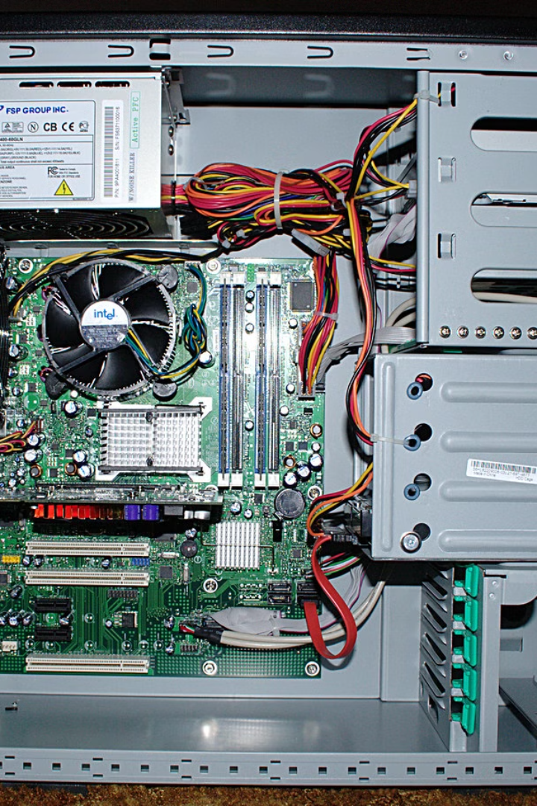
Main Computer Parts Explained
1
Central Processing Unit (CPU)
The brain of the computer.
It does all the thinking and calculations.
Example: If you open a program, the CPU makes it work.
2
Random Access Memory (RAM)
The short-term memory of the computer.
It stores data that the computer is currently using.
Example: When you open a browser or a game, it uses RAM to run smoothly.

Slide 3
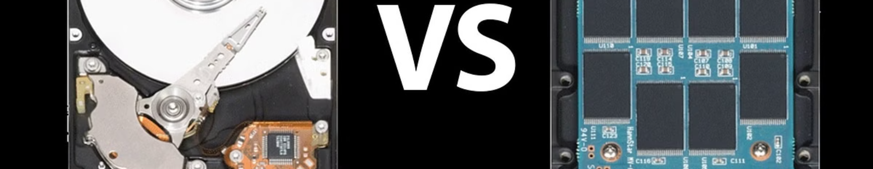
Storage and Motherboard
Storage (Hard Drive or SSD)
Motherboard
The long-term memory of the computer.
The main circuit board of the computer.
It stores all your files, programs, and operating system.
It connects all the parts together so they can communicate.
Hard Drive (HDD): Slower but cheaper.
Example: The CPU, RAM, and storage are all attached to the motherboard.
Solid State Drive (SSD): Faster but more expensive.

Slide 4
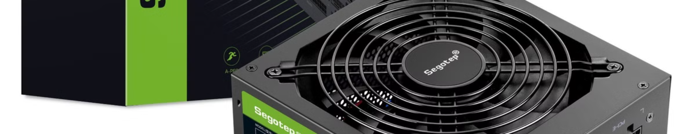


Power Supply and Graphics Processing Unit
Power Supply Unit (PSU)
Graphics Processing Unit (GPU)
Provides power to all the parts of the computer.
Handles images, videos, and games.
Without it, the computer won't turn on.
It makes everything look good on your screen.
Example: If you play a game, the GPU creates the graphics.

Slide 5
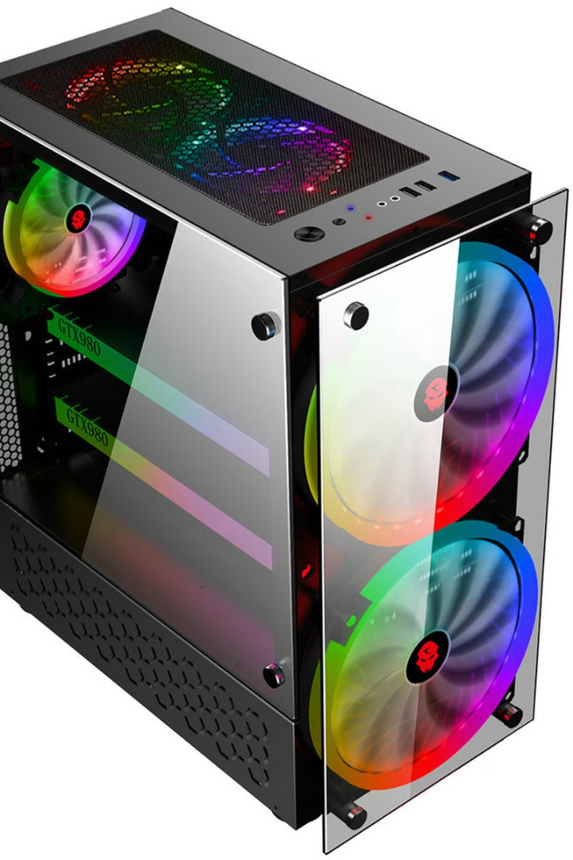
Cooling System and Case
Cooling System (Fans or Liquid Cooling)
Keeps the computer cool so it doesn't overheat.
Example: Fans blow air to cool down the CPU and GPU.
Case
The outer box that holds all the parts together.
Protects the parts and keeps them organized.

Slide 6

Input and Output Devices
Input Devices
Output Devices
Tools you use to give commands to the computer.
Tools the computer uses to show or give you information.
Examples: Keyboard (for typing), Mouse (for clicking).
Examples: Monitor (displays images), Printer (prints documents).

Slide 7
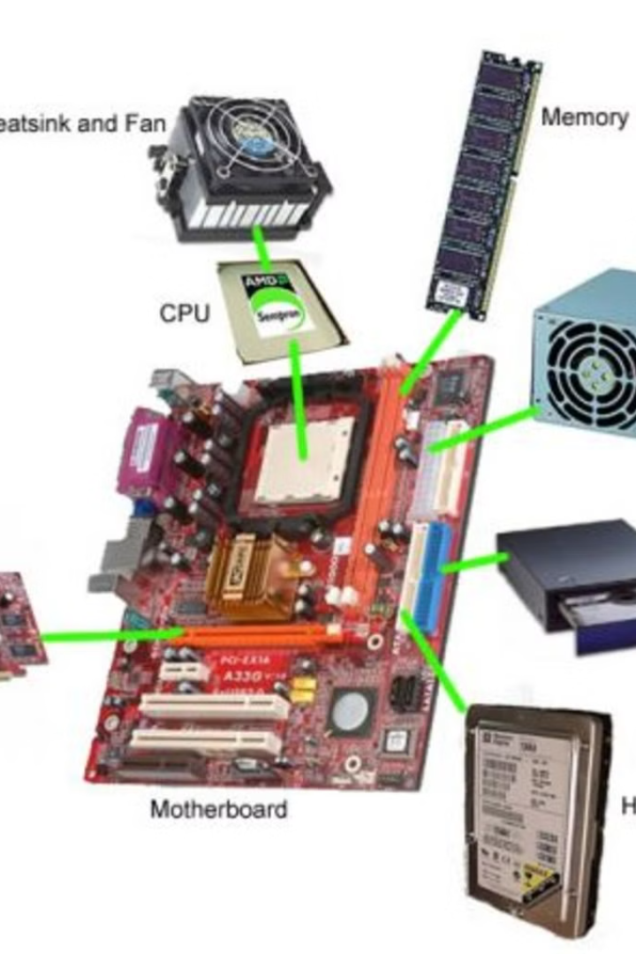

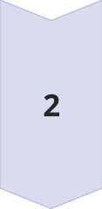
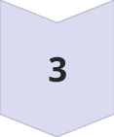
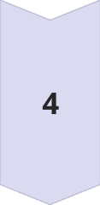
How Do These Parts Work Together?
Input
You type on the keyboard (input device) to open a program.
Processing
The CPU processes your command.
The RAM helps the CPU by storing temporary data.
The storage holds the program files.
Output
The GPU creates the images and displays them on the monitor (output device).
Support
The motherboard connects all these parts so they can work together.
The power supply provides electricity to keep everything running.
The cooling system prevents the computer from overheating.

Slide 8
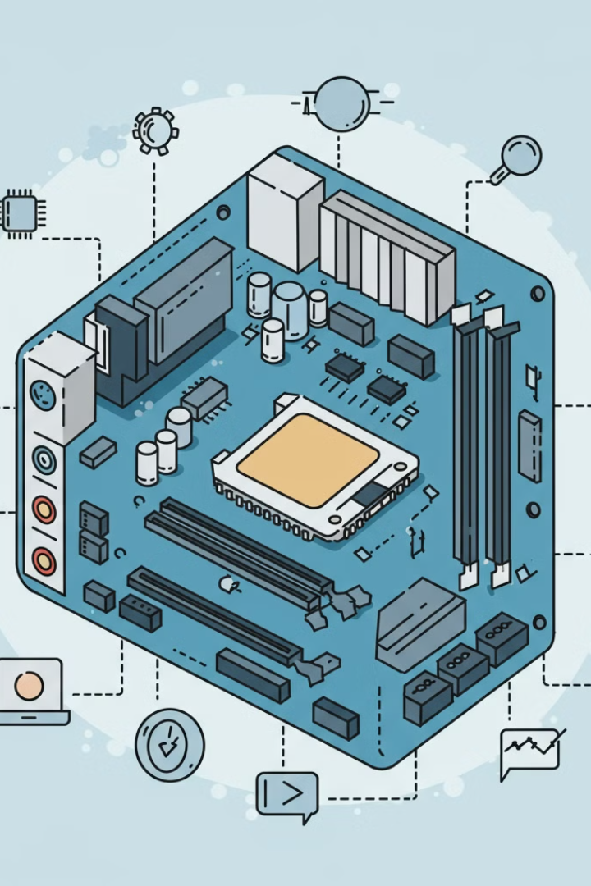
Why Are These Parts Important?
1
Each part has a specific role that helps the computer function.
2
If one part is missing or not working, the computer may not work properly.
3
Upgrading parts (like adding more RAM or a better GPU) can make the computer faster and more powerful.

Slide 9










Simple Summary
CPU
RAM
Storage
Motherboard
The brain.
Short-term memory.
Long-term memory.
Connects everything.
Power Supply
GPU
Cooling System
Case
Provides electricity.
Handles graphics.
Keeps the computer cool.
Holds all the parts.
Input Devices
Output Devices
Keyboard, mouse.
Monitor, printer.

